Slide 1
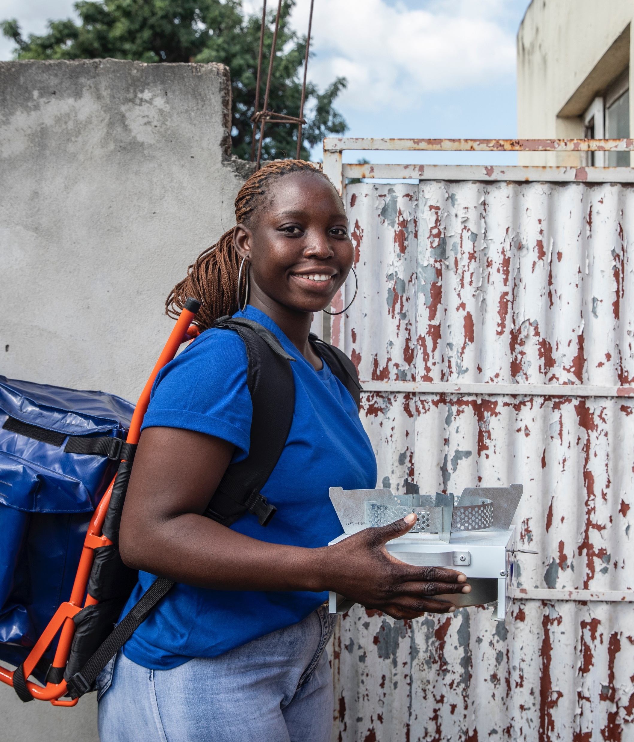

Unleashing the Power of Youth-led Change in Clean Cooking
Youth Energy Summit | Nairobi
22 June 2023

Slide 2
Clean Cooking is a Youth Issue
1
Household air pollution kills more than
237,000 children annually
2
244 million children & youth are out of school
3
Over 80% of displaced people use firewood & charcoal for cooking
4
70 million young people are unemployed

Slide 3
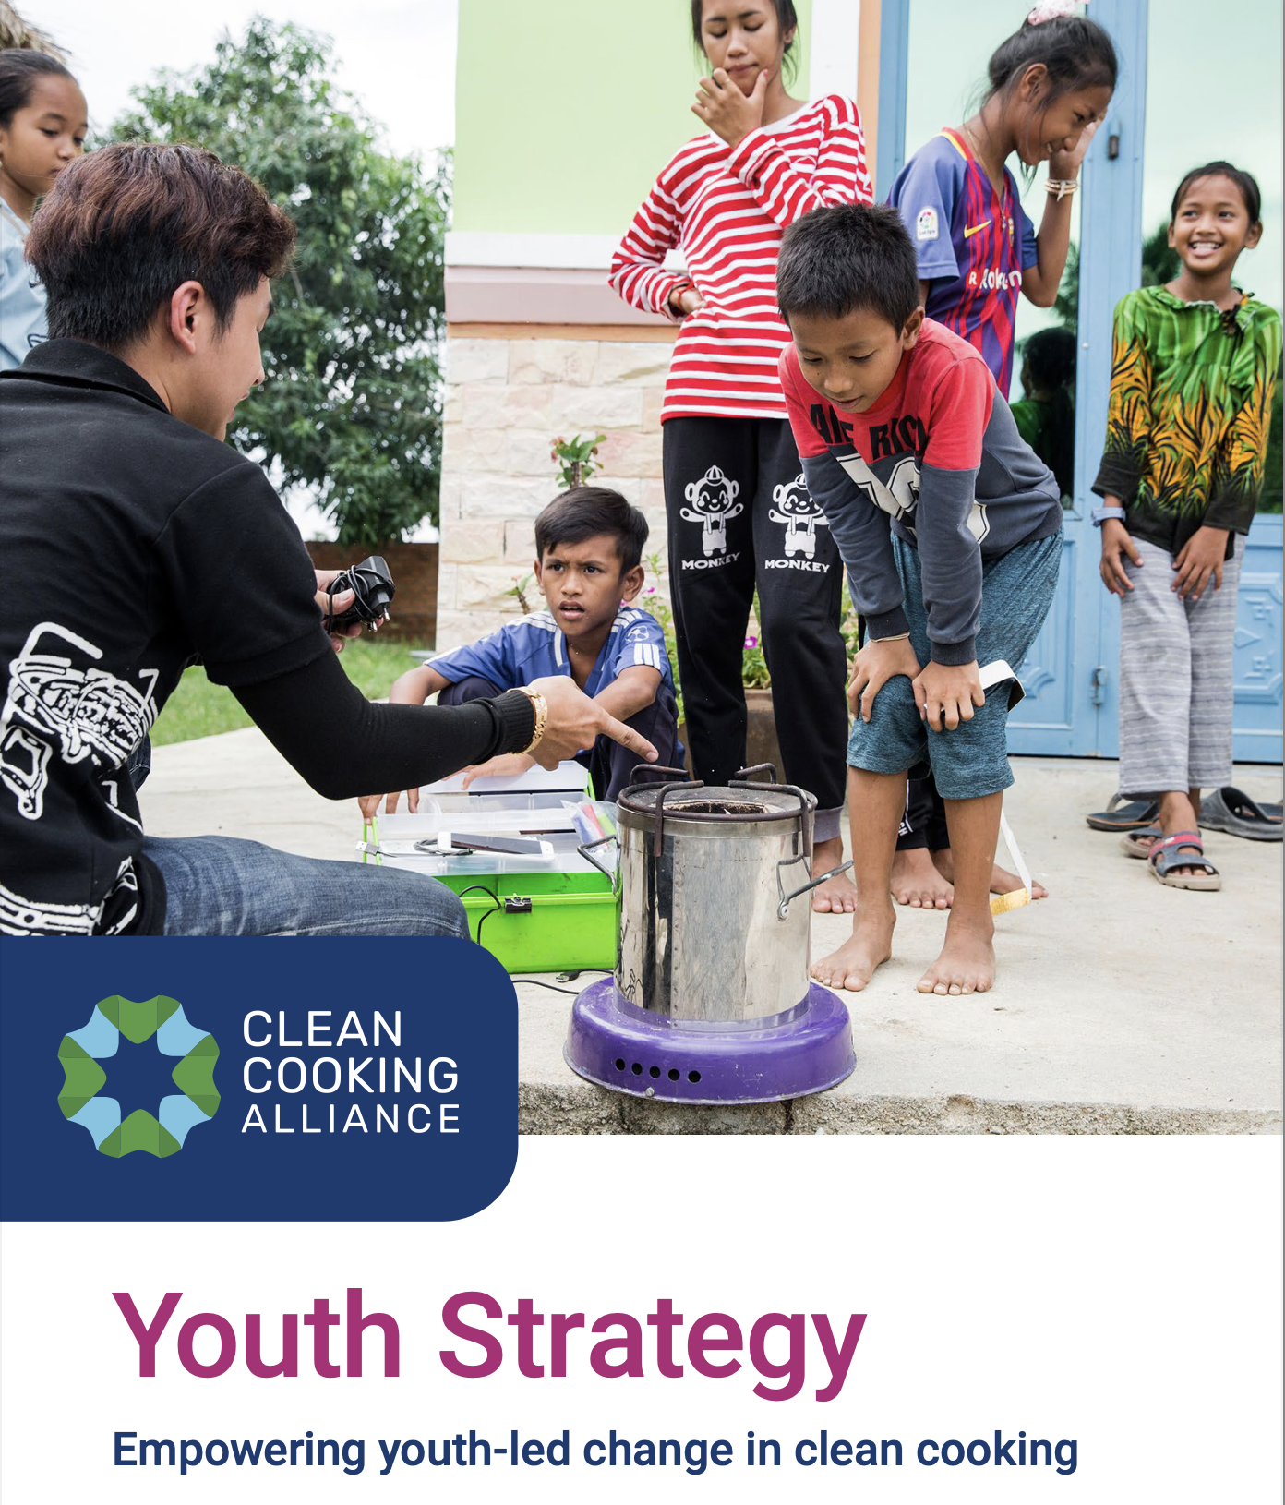
CCA Youth Strategy
Empowering Youth-led Change in Clean Cooking
OFFICIAL LAUNCH

Slide 4
CCA’s Youth Strategy
CCA’s Youth Strategy covers three key fundamental aspects of youth engagement in clean cooking:
Awareness
Empowerment
Action
Support capacity building to equip youth with relevant knowledge & skills
Elevate & engage youth voices as critical stakeholders in the ecosystem
Work with youth & partners to develop & support awareness-raising resources & activities

Slide 5
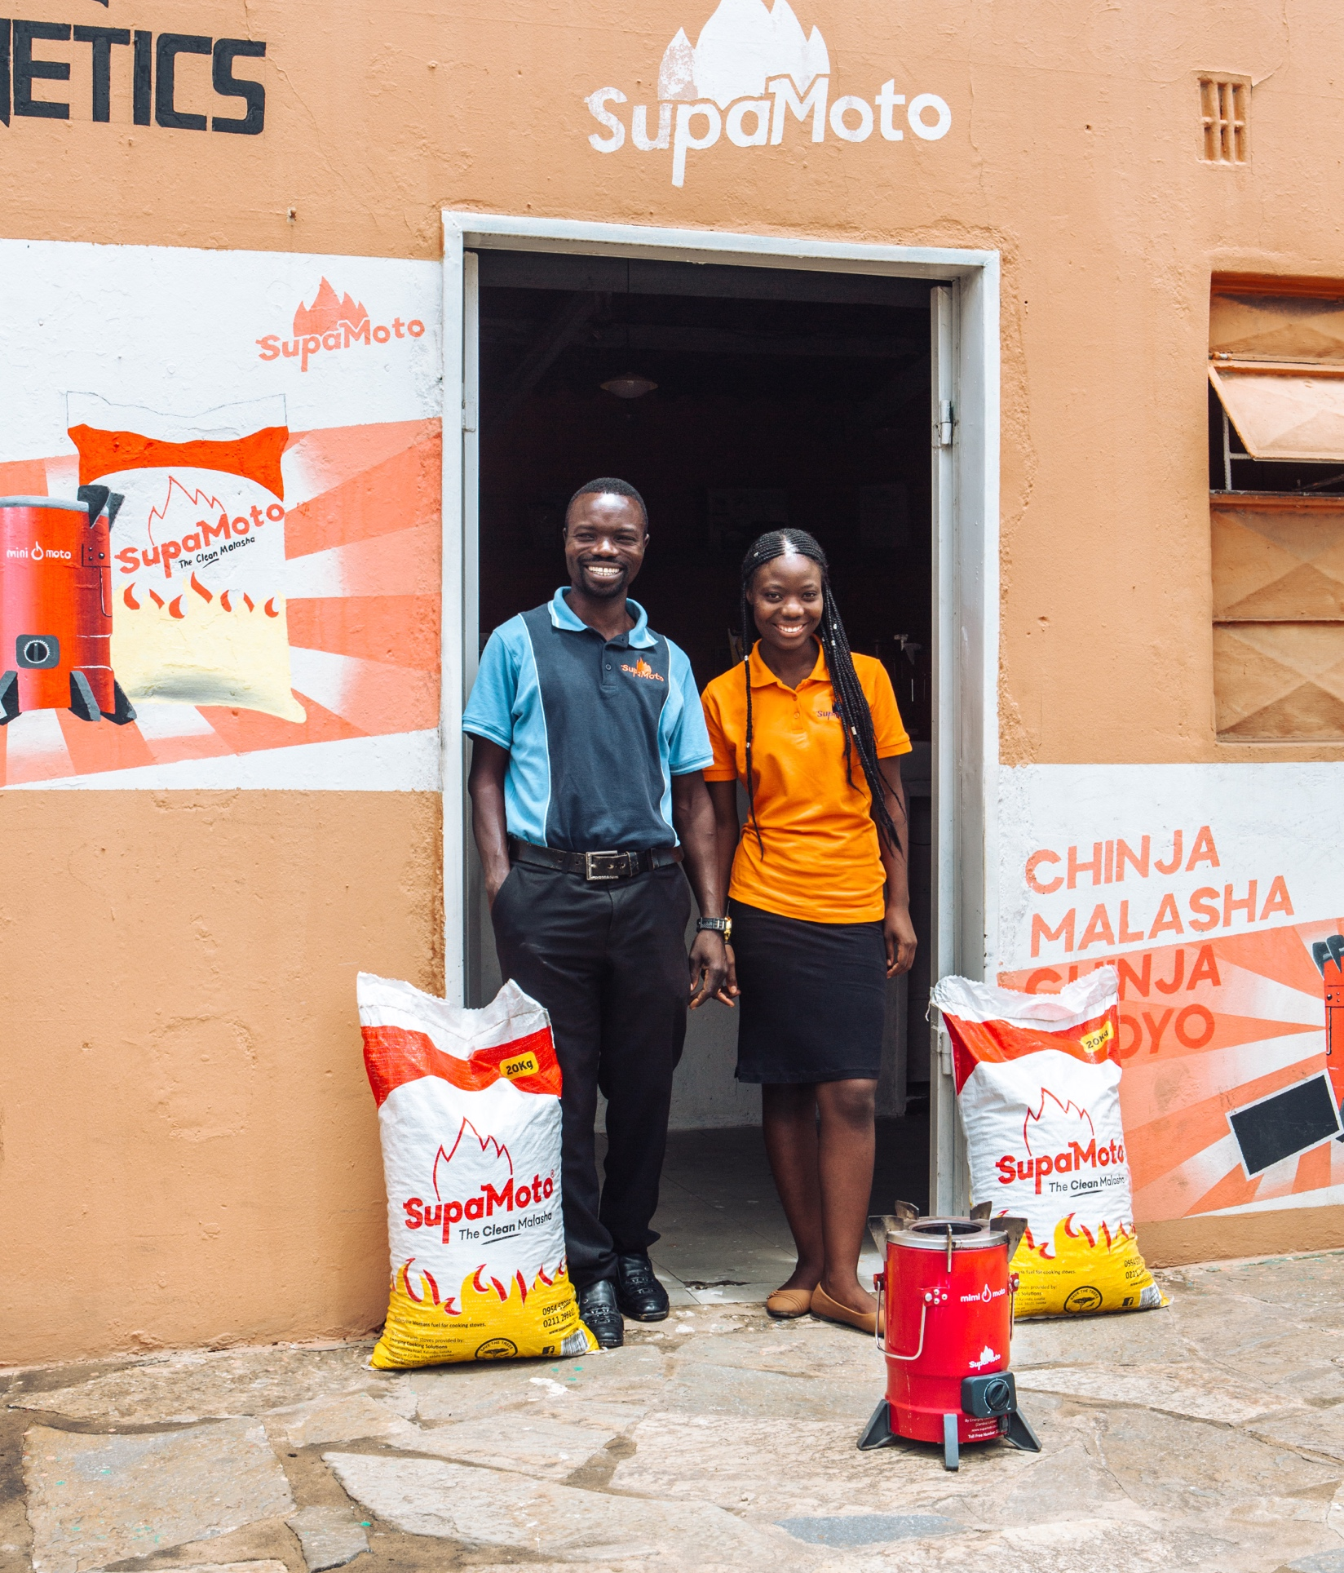

Youth Accelerator in Clean Cooking
Student Energy &
Clean Cooking Alliance
Announcement & Call for Funders

Slide 6
Unleashing the Power of Youth-led Change in Clean Cooking
Youth Energy Summit | Nairobi
22 June 2023

Slide 7
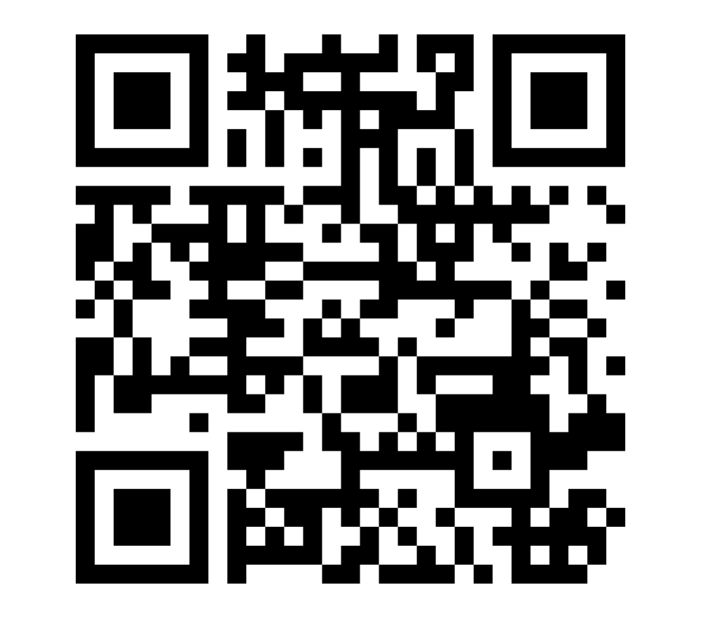
Audience Poll Question #1
Why is clean cooking essential?
Mitigates climate change
Empowers women & girls
Reduces exposure to harmful smoke
Enables youth to improve their quality of life

Slide 8
Unleashing the Power of Youth-led Change in Clean Cooking
Youth Energy Summit | Nairobi
22 June 2023

Slide 9
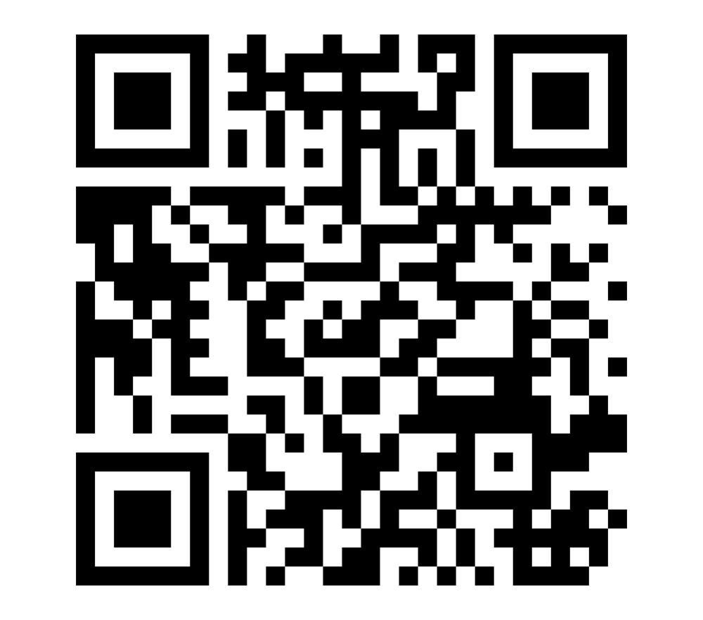
Audience Poll Question #2
What is needed for youth to lead in clean cooking?
Increased awareness
Education & skill-training opportunities
Inclusive platforms to voice their needs
Mentorship & funding opportunities

Slide 10
Unleashing the Power of Youth-led Change in Clean Cooking
Youth Energy Summit | Nairobi
22 June 2023

Slide 11

Thank you!
Scan to download CCA's Youth Strategy and read more about the Youth Accelerator!

Slide 12
Unleashing the Power of Youth-led Change in Clean Cooking
Youth Energy Summit | Nairobi
22 June 2023

